Slide 1
Colonial America
Newspaper Resources
Notes:
1

Slide 2
Introduction
You have just been hired by The Colonial Times newspaper.
The Colonial Times happens to have technology allowing them to bring people from the past into current times!
You will have the opportunity to “interview” European colonists and learn about Colonial New Jersey and the American Revolution.
You will write news articles reporting about how the colonist felt to sail to colonial New Jersey from England, their daily life, the causes and results of the American Revolution, and the Declaration of Independence.
Notes:
2

Slide 3
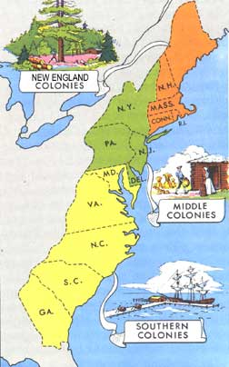
Article 1 The Night Before the Colonist Set Sail to the Colony of New Jersey!
You are interviewing an English family from 1769. The family is leaving tomorrow for the New World. You need to find who they will be traveling with or leaving behind. Explain how they are feeling. Are they scared or excited to sail to the colony of New Jersey? Do they get to bring anything special with them? What do they expect when they arrive in their new country? Why they are leaving England for the Colony of New Jersey?

Slide 4
Article 2 Everyday Life in the colony of New Jersey
Describe what daily life is like in New Jersey in the year 1770. This entry should include information on such things as food, education, the church, farming, clothes, and games. You can watch the following videos and/or explore the following websites to discover what life was like in Colonial America:
You can watch the following videos and/or explore the following websites to discover what life was like in Colonial America:
Background
Life as a Child in the 18th Century (YouTube)
Colonial Life
(CONTINUED NEXT SLIDE)
Notes:
4

Slide 5
Article 2 Everyday Life in the colony of New Jersey
(Continued from previous slide)
Colonial Cooking (YouTube)
Food
Education/Schools
Religion
Farming
Learn about Clothing
Children’s Clothing
Eighteenth Century Clothing (YouTube)
Women's Clothing
Men's Clothing
Toys and Play in Eighteenth Century America (video)
Toys and Games
Toys
More toys
Colonial Fun
Games
For More Information: Go to trueflix.scholastic.com
Username: wcresthome
Password: wcresthome
Click The Thirteen Colonies
Click The New Jersey Colony book
Chapter 3 "Everyday Life“

Slide 6
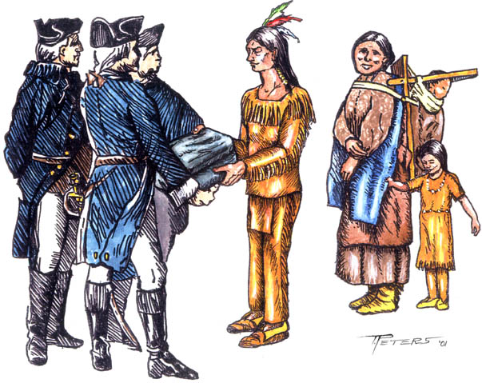
Article 3 Clash of Cultures: Colonists and Native Americans
By 1771, the Colonists have made friends with the Native people. During their friendship, they have noticed some similarities and differences between the Colonists way of life and the Native American way of life. After watching/reading the following sites, tell why there was conflict and describe the similarities and differences between the two groups of people in your article. You could even include quotes from the Colonists or Native Americans that you “interview”.
Watch the videos. It shows how the Native Americans lived.
Lenape
Plimoth Virtual Tours- Wampanog
Comparing styles of living
Go to trueflix.scholastic.com
Username: wcresthome
Password: wcresthome
Click The Thirteen Colonies
Click The New Jersey Colony book
Chapter 1 "Native Americans" and
Chapter 2 "A New Colony"
Notes:
6

Slide 7
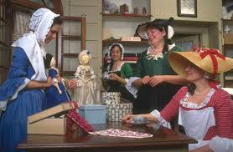
Article 4 Choosing a Trade
By age 13, colonial children have to learn a trade. Your job is to report back what traders are available in the year 1773.
Click on the sites below and to see their choices for a trade where boys will become an apprentice (someone who learns a trade) and girls only had a few options.
Boys:
List and Descriptions of Trades or
History of Colonial Occupations
Apprentice
Girls:
Read about the roles of women
1. Huswifery - Learning how to maintain a house (cooking, cleaning, sewing, etc.)
2. Milliner-Working as a dressmaker/seamstress and possibly owning your own shop.
3. Household Servant - Working in another family’s home.
For this article, describe what it is like for the colonist to learn a trade. What are their responsibilities? Do they miss going to school? What is the best part and worst part of learning this trade? Share their feelings about this new experience. This could also be completed in the form of Help Wanted ads in your newspaper, which list the requirements for the trade.

Slide 8
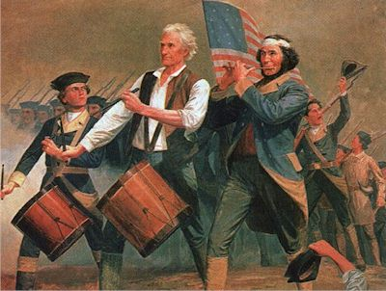
Article 5 The American Revolution has Begun!
In 1775, the Revolution has begun!
For this article, describe some of the events that have happened that have led up to the American Revolution. What were some of the causes? How do the colonists feel about the war? The sites below will give you some background information. Use some of the following resources:
Go to trueflix.scholastic.com
Username: wcresthome Password: wcresthome
Click The Thirteen Colonies
Click The New Jersey Colony book
Chapter 4 “Road to Independence”
Go to freedomflix.digital.scholastic.com
Username: knight Password: school
Click on Colonial Ear
Click on The Revolutionary
American Revolution Reading Comprehension
Causes and Effects of the American Revolution
Causes for the Revolution
American Revolution (YouTube video)
Notes:
8

Slide 9
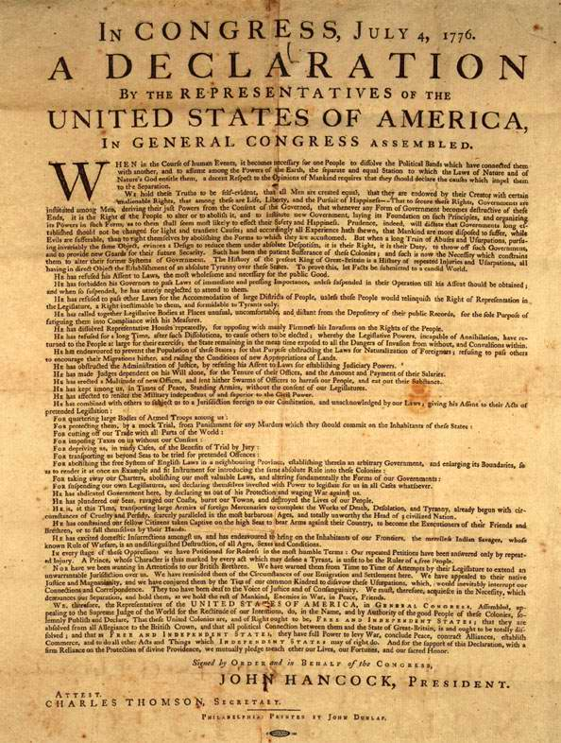
Article 6 The Declaration of Independence
On July 4, 1776, Congress declared its independence from Britain in the form of a document called The Declaration of Independence.
For this article, describe the Declaration of Independence. Why was it so important? What were the results of the Colonies declaring its independence from Britain? How do they feel about all of this? Use the possible resources:
Go to trueflix.scholastic.com
Username: wcresthome Password: wcresthome
Click U.S. Government
Click The Declaration of Independence
book
Go to freedomflix.digital.scholastic.com
Username: knight Password: school
Click on Colonial Era
Click on The Declaration of Independence book
Declaration of Independence short video
Why We Celebrate the 4th of July

Slide 10
Article 7 General George Washington Extra Credit Entry (Optional)
Here are some resources:
George Washington
George Washington
YouTube video
In 1777, the Revolution is still going on. You are reporting on a remarkable leader of the Continental Army, General George Washington. What interesting facts have you heard about him? What do you think is the most fascinating thing about him? If you got to interview him, what would you ask him if you met him?
Click to learn more about the life of General George Washington and then write your article.

Slide 11
Games and Puzzles
Play the following games:
Various Colonial Games
The Jamestown Online Adventure
Colonial House
Explore more
Colonial Williamsburg Kids Zone
Plimouth Plantation
U.S. Mint Time Machine
Liberty's Kids

